Slide 1
MICROSERVICES

Slide 2
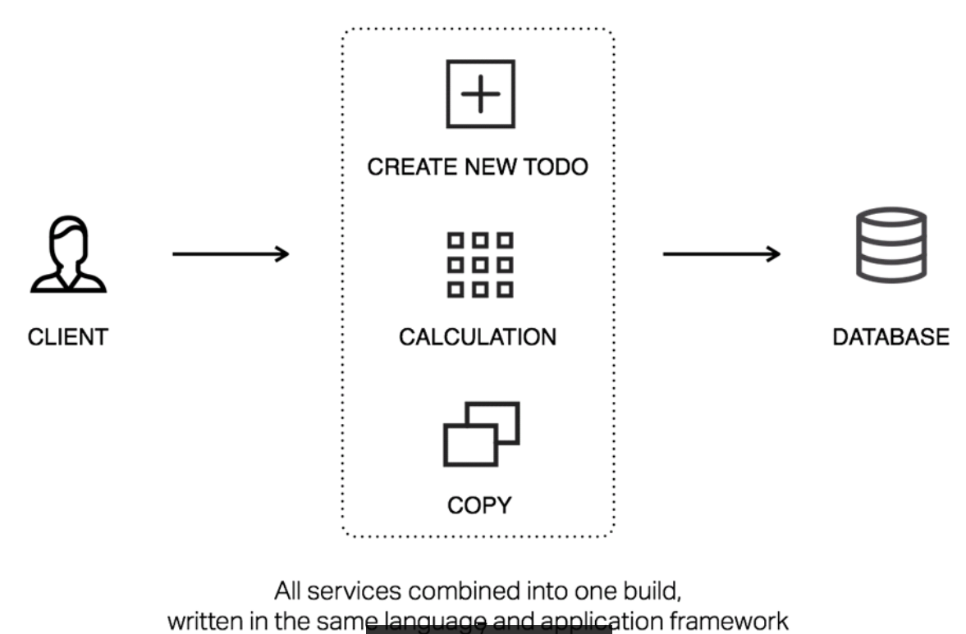
Monolith Architecture
Application is written as one cohesive unit of code
Components share the same memory space and resources
If any program component must be updated, the whole application has to be rewritten
Typically provides better throughput
Absence of abstraction layers – APIs
Useful for projects with very small and easy scope
Notes:
http://whatis.techtarget.com/definition/
http://odino.org/on-monoliths-service-oriented-architectures-and-microservices/
A monolithic architecture means that your app is written as one cohesive unit of code whose components are designed to work together, sharing the same memory space and resources.

Slide 3
SOA Architecture
A service is a reusable component that can be used as a building block to form larger, more complex application functionality
In SOA different services communicate with each other to perform activities
Service consumer and service provider communicate with pre defined protocols
Services can be reused in other applications independent of interaction with other services
Facilitates the development of a complex product by integrating different products from different vendors independent of the platform and technology
Notes:
http://www.ehealthblueprint.com/en/documentation/chapter/characteristics-of-service-oriented-architecture-services
http://searchmicroservices.techtarget.com/definition/service-oriented-architecture-SOA
https://www.buzzle.com/articles/advantages-and-disadvantages-of-service-oriented-architecture-soa.html

Slide 4

Problems with Monolith
Difficult to scale
Difficult to maintain in large applications
Must redeploy the entire application upon each update
Lesser reliability
Expensive in time and cost to adopt new technologies / platforms
Large size of application leads to more start up time
Monolithic applications can evolve into a situation where no single developer understands the entirety of the application.
Notes:
Lesser reliability : Bug in any module (e.g. memory leak) can potentially bring down the entire process.

Slide 5

The solution ......Microservices
Services communicate with each other over the network
Service Oriented architecture composed of loosely coupled elements that have bounded contexts
-Adrian Cockcroft
Updating one service does not require updating other services
Self contained- update the code without knowing the internals of microservices
Notes:
Microservices are small, independent services that work together. In other words, these services are small, highly decoupled and focus on doing a small task at a time.

Slide 6
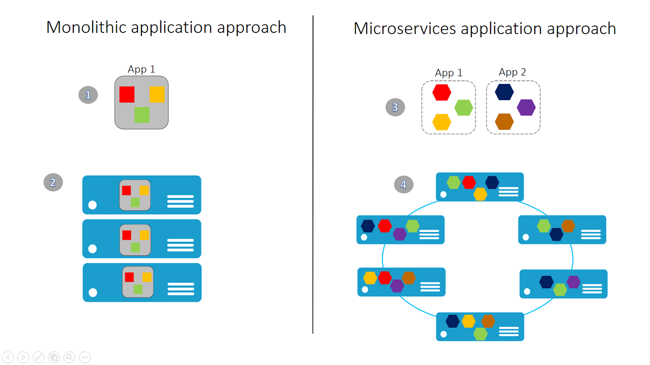
Advantages
Easy to enhance – less dependency and easy to change and test
Easy to understand since they represent the small piece of functionality
Freedom to choose technology – allows you to choose technology that is best suited for a particular functionality
Resilient/Flexible – failure in one service does not impact other services.
Follow the Single Responsibility Principle
Notes:
https://docs.microsoft.com/en-us/azure/service-fabric/service-fabric-overview-microservices

Slide 7
Synchronous mode
A user-facing service made up of a series of microservices communicating synchronously
One microservice relies on another which in turn may rely on another microservice and so on
Problem : If one service fails, it will set off a chain of failures leading to a denial of service to the end user
If one service is slow then response time of the whole application slows down
Notes:
https://thenewstack.io/synchronous-rest-turns-microservices-back-monoliths/

Slide 8
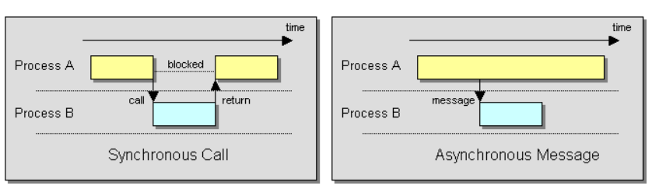
Asynchronous mode
The calling service does not wait for a response from the called service
The calling service is not dependent on the called service
If they fail, the calling service will continue to operate
Threads of the calling services aren’t blocked anymore by waiting for a response
Notes:
https://www.tothepoint.company/blog/microservices-the-most-occurring-obstacles/

Slide 9
Communication types
Synchronous protocol vs. Asynchronous protocol
Single receiver vs. Multiple receivers

Slide 10
Request/response communication with HTTP and REST
A client sends a request to a service. The service processes the request and sends back a response
Based on HTTP protocol
Well-suited for querying data for a real-time user interface
Client typically assumes the response will come in a very short time
Notes:
https://docs.microsoft.com/en-us/dotnet/standard/microservices-architecture/architect-microservice-container-applications/communication-in-microservice-architecture
Example: REST
In case of delayed response, asynchronous communication based on messaging patterns and messaging technologies is better and more suitable.

Slide 11
Push and real-time communication based on HTTP
Server pushes content and data to multiple clients as data is available
Server does not wait for client’s request
Usually handled by a protocol such as WebSockets
Client apps show the changes immediately due to real-time communication
Notes:
https://docs.microsoft.com/en-us/dotnet/standard/microservices-architecture/architect-microservice-container-applications/communication-in-microservice-architecture
Example: A service communicates a change in the score of a sports game to many client web apps simultaneously.

Slide 12
Single receiver message-based communication
One microservice sends a message to exactly one microservice
The message is processed only once
Well suited for sending asynchronous commands from one microservice to another
Notes:
https://docs.microsoft.com/en-us/dotnet/standard/microservices-architecture/architect-microservice-container-applications/asynchronous-message-based-communication

Slide 13
Multiple receivers message-based communication
Sender microservice can send messages to multiple microservices
Microservices or applications can subscribe to one service. When the service publishes a message, all the subscribers will receive it (publish/subscribe mechanism)
Flexible to add more subscribers to a service in the future
Notes:
https://docs.microsoft.com/en-us/dotnet/standard/microservices-architecture/architect-microservice-container-applications/asynchronous-message-based-communication

Slide 14
Asynchronous event-driven communication
A microservice publishes an event to other microservices when something has changed or happened
A microservice that receives an event can subsequently publish another event to another microservice
An event bus is a channel/interface for services to subscribe/ unsubscribe to events, and to publish events
This communication model helps achieve eventual consistency among microservices
Notes:
https://docs.microsoft.com/en-us/dotnet/standard/microservices-architecture/architect-microservice-container-applications/asynchronous-message-based-communication

Slide 15
Scaling techniques for microservices
Vertical scaling: adding more computing resources to existing machines
Horizontal scaling: adding more machines to your system
Each microservice can use a different way to scale itself

Slide 16
Vertical scaling
Easy to scale by upgrading existing machines
Adding more processing cores, more memory, faster disks, …
Constraint on hardware capability
More powerful machine can be much more expensive
Always pay the cost of the powerful machine even when load reduces
If the machine is down, the whole system is down
Notes:
https://www.g2techgroup.com/horizontal-vs-vertical-scaling-which-is-right-for-your-app/
https://blog.appdynamics.com/product/scaling-application-efficiently-horizontal-vertical/

Slide 17
Horizontal scaling
Adding more hosts or servers, and deploying the same software on them
Can handle more load at a better cost than vertical scaling
Easy to descale by removing hosts/servers when load reduces
More reliability and availability
Notes:
https://www.g2techgroup.com/horizontal-vs-vertical-scaling-which-is-right-for-your-app/
https://blog.appdynamics.com/product/scaling-application-efficiently-horizontal-vertical/

Slide 18
THANK YOU

